Slide 1

BY PEACE AGHEDO

Slide 2
Step 1
Getting Started

Slide 3
Marketing Objective
To get 60 new readers for my blog post() withing 4 months (of publishing the artice) without spending 1 naira for ads.

Slide 4
KPI
The primary KPI to measure the marketing success would be the number of new readers i get for my blog().

Slide 5
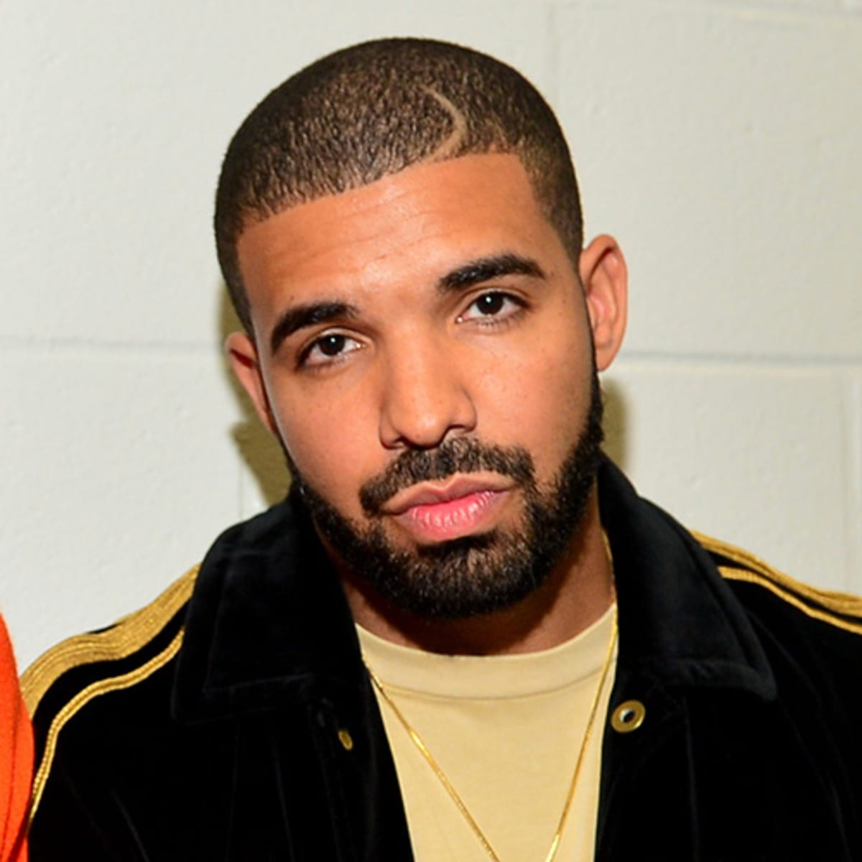
Target Persona
Background and Demographics | Target Persona Name | Needs
AGE: 40 GENDER: Male MARITAL STATUS: Married NUMBER OF CHILDREN: 3 COUNTRY: Nigeria STATE OF RESIDENCE: Edo EMPLOYED: Yes ANNUAL INCOME: 1 million naira HIGHEST CERTIFICATION: Masters Degree | MATTHEW | Sufficient internet network. Projects to practice Digital Marketing. Better work and better cash inflow. Tutorial videos
Hobbies | Goals | Barriers
Play FIFA PES Travel Singing Dancing Chess | A better job Does not see self in this same industry in the next 3 years. Sees self as a high profiled Digital Marketer in the next 3 years. | High cost of data poor Internet Financial constraints Too many responsibilities at work.

Slide 6
Step 2
Write a Blog Post

Slide 7
What is the theme and framework of your blog post?
Provide a brief summary of your blog post including the following:
Select a theme for your blog post:
I Choose “Why have you decided to take the Digital Marketing Nanodegree Program?
2. What is the framework of your blog post?
I will use: SCQA also called the Pyramid Principle

Slide 8

Blog Post
source:https://www.forbes.com/sites/cathyhackl/2020/06/24/how-technology-will-create-these-7-jobs-in-the-future/?sh=5855b5297437
The world is in a digital age, and millions of people spend so much of their time poking around digital platforms. The IT Industry is a major component of any fast growing and successful economy. Every Business or Organization requires the skill of IT professionals and masterminds to be truly effective and rise above competition in their various field. Businesses/Organizations are becoming increasingly aware of this fact and therefore leveraging on the popularity of these platforms to promote their goods and services. Read on: https://medium.com/@peaceaghedongozi/major-reason-why-i-signed-up-for-udacity-digital-marketing-nanodegree-b96bdafb44bd

Slide 9
Step 3
Craft Social Media Posts

Slide 10
Summary
Choose three social media platforms you will use to promote your blog.Write a short explanation about why you chose those platforms.
i will promote my blog on the following 3 social media platforms because these are the main social media networks the target persona hangs out primarily.
LinkedIn: it is a professional network where prosioonal informations and ideas are shared. since my blog post is about jobs, skills and personal experiences, it will be an excellent content for LinkedIn users. I used avery sober, professional tone for my LinkedIn post.
Twitter: This platform is also great for dessiminating information. it is used by recruiters and brands across the world. I used a short note for twitter to keep the character limiy constraints.
Facebook: this is most used by my target persona. it is a global platform for exchanging news and information, both professional and personal. I used a semi-personal tone for my facebook.

Slide 11
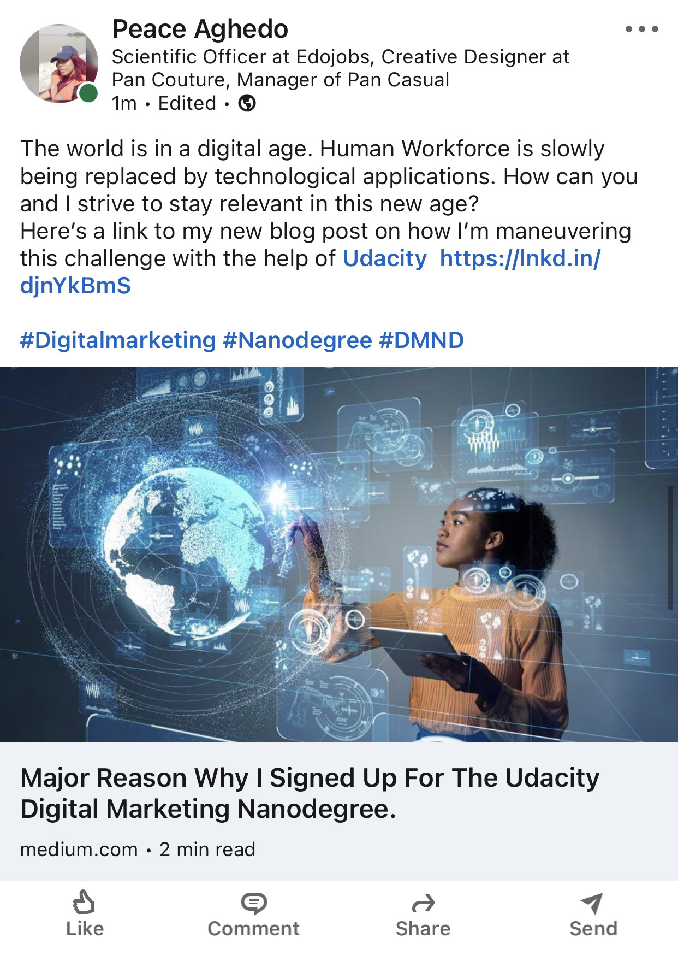
Platform 1 and Post
LINKEDIN POST

Slide 12
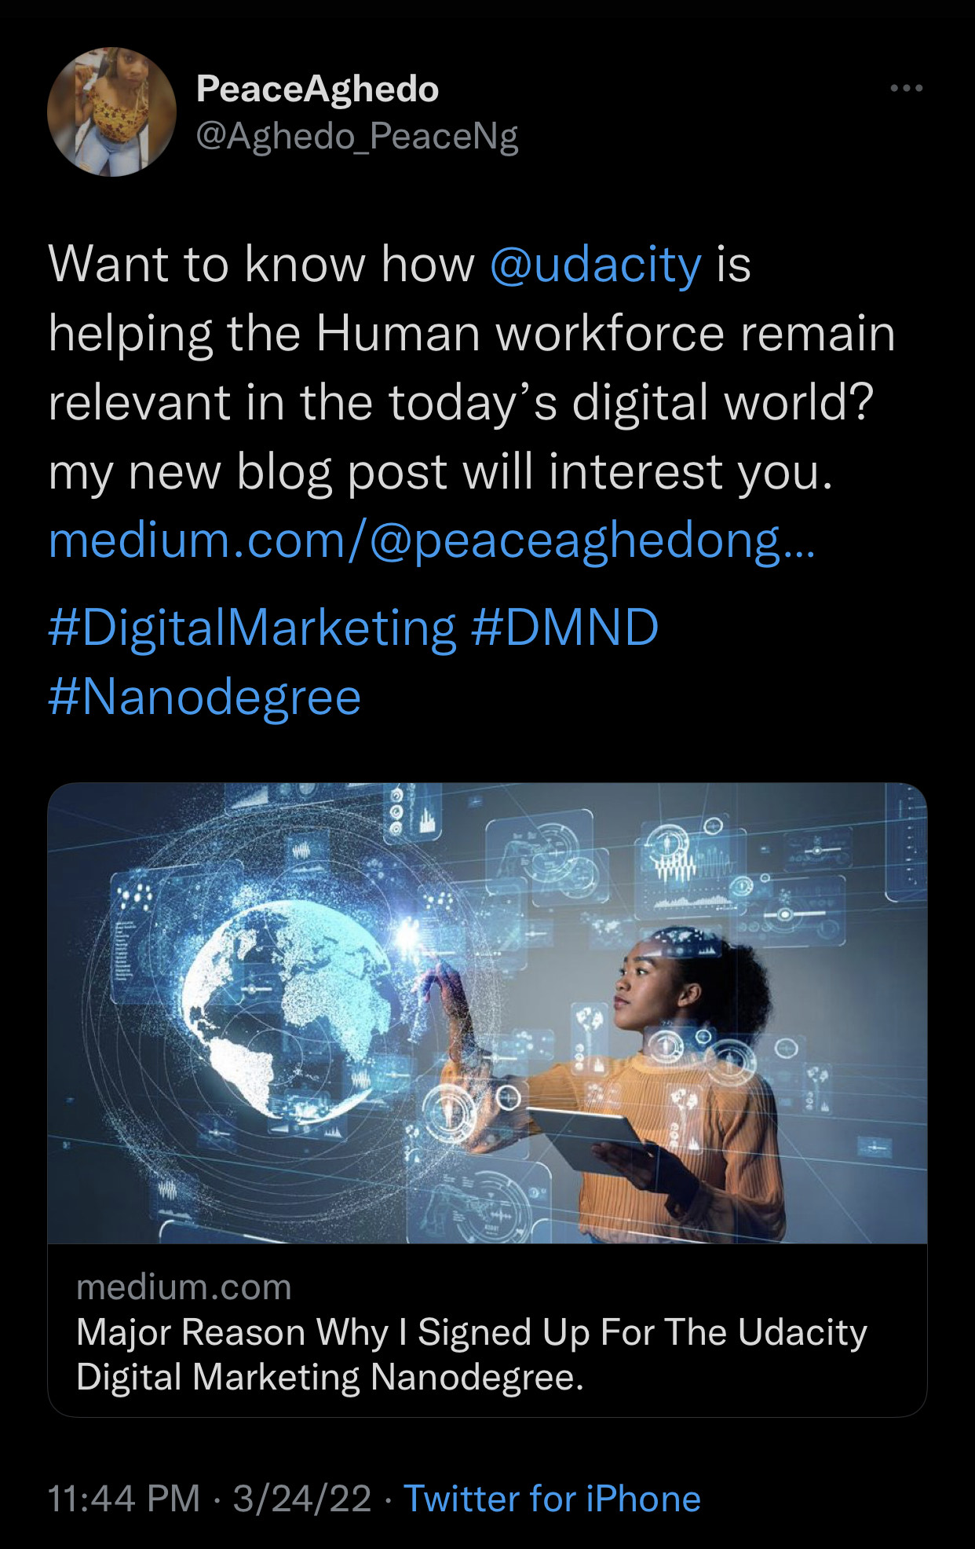
Platform 2 and Post
TWITTER POST

Slide 13
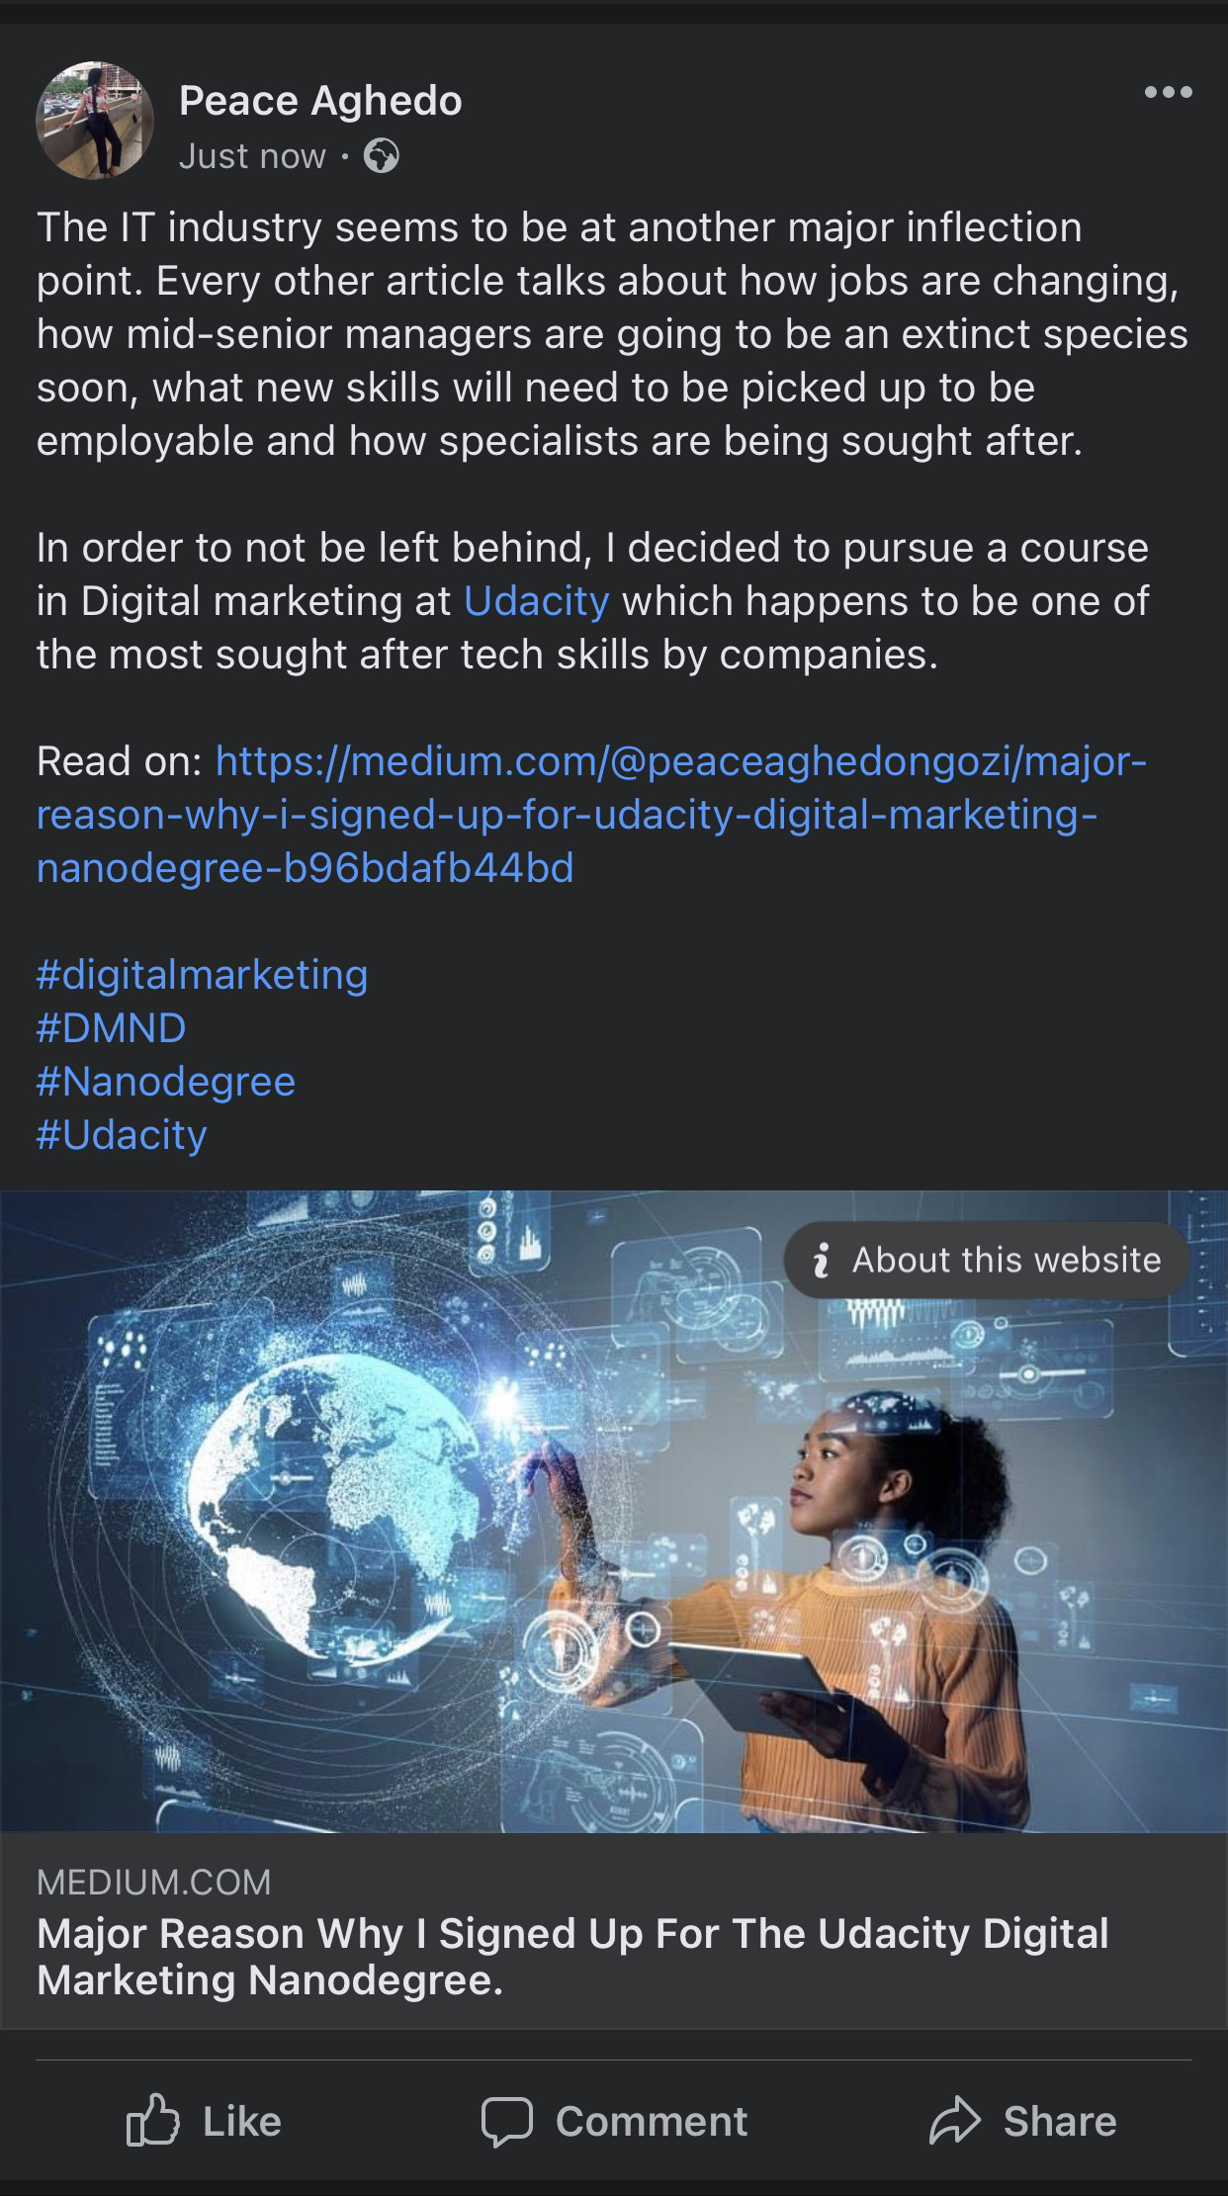
Platform 3 and Post
FACEBOOK POST

